Slide 1
🕵️‍♂️ Steganogarphy Hiding Information In the Image
CAPSTONE PROJECT
Presented By:
Student Name : N Ganapati
College/University Name : Nalanda Institute of Technology [NIT], Bhubaneswar
Department : Computer Science and Engineering
Student ID: STU66c45dec6df161724145132
Internship ID: INTERNSHIP_17448908156800ebbf97a5d
AICTE Batch1_2025-26(CS) : 20th May 2025 to 24th June
GitHub: : https://github.com/ganapati113/Edunet-Foundation-Steganogarphy-Hiding-Information-In-the-Image.git

Slide 2
OUTLINE
Problem Statement
System Development Approach
Algorithm & Deployment
Result
Conclusion
Future Scope
References

Slide 3
PROBLEM STATEMENT
Project Overview – Steganography: Hiding Messages in an Image
This project is all about implementing image-based steganography, a powerful technique that hides secret messages within digital images without changing how they look. We developed a Python GUI tool using Tkinter and PIL that allows users to encrypt (hide) and decrypt (reveal) secret messages in just a few clicks. The system uses the Least Significant Bit (LSB) method to embed data into image pixels, ensuring the original image remains visually unchanged. Our goal was to demonstrate how data security and privacy can be enhanced using creative image manipulation techniques. Through this, we’ve also explored real-world concepts in cybersecurity, encryption, and digital forensics.

Slide 4
SYSTEM APPROACH
The development of this steganography tool follows a structured and modular approach to ensure clarity, scalability, and ease of use. The system is designed to allow users to encrypt and decrypt messages within images using a graphical interface, with minimal technical effort required from the user.
System Requirements:
Operating System: Windows / Linux / macOS
Python Version: Python 3.7 or above
RAM: Minimum 2 GB (4 GB recommended for smooth performance)
Storage: Minimum 100 MB free disk space
Image Format Support: PNG, JPEG, JPG
Libraries Required to Build the Model:
Tkinter: For designing the user-friendly GUI
PIL (Pillow): For image processing and pixel manipulation
filedialog & messagebox (from Tkinter): For file browsing and user notifications
This system ensures minimal dependencies, making it easy to deploy and use even on low-end machines. The use of Python and open-source libraries also ensures cross-platform compatibility and customization flexibility.

Slide 5
ALGORITHM & DEPLOYMENT
The project is based on image steganography, where a secret message is hidden within a digital image in such a way that
the human eye cannot detect any changes. This is achieved by altering the Least Significant Bit (LSB) of pixel values in
the image.
The process is divided into two major phases:
🔐 Encryption Phase:
The user inputs a secret message and selects a cover image.
The message is converted into binary.
Each binary bit is embedded into the red channel’s LSB of image pixels.
A special binary delimiter is added to mark the end of the message.
The result is a new image file that visually looks unchanged but contains hidden data.
🔓 Decryption Phase:
The encoded image is loaded through a GUI.
The system reads the LSBs from the red channel of each pixel.
It continues until the delimiter is detected.
The binary data is then grouped into bytes and converted back into readable text.
This approach uses a lightweight and intuitive Python GUI, ensuring accessibility and simplicity while highlighting real-world
data hiding techniques. The algorithm ensures that image quality is preserved while the confidentiality of the message is
maintained.

Slide 6
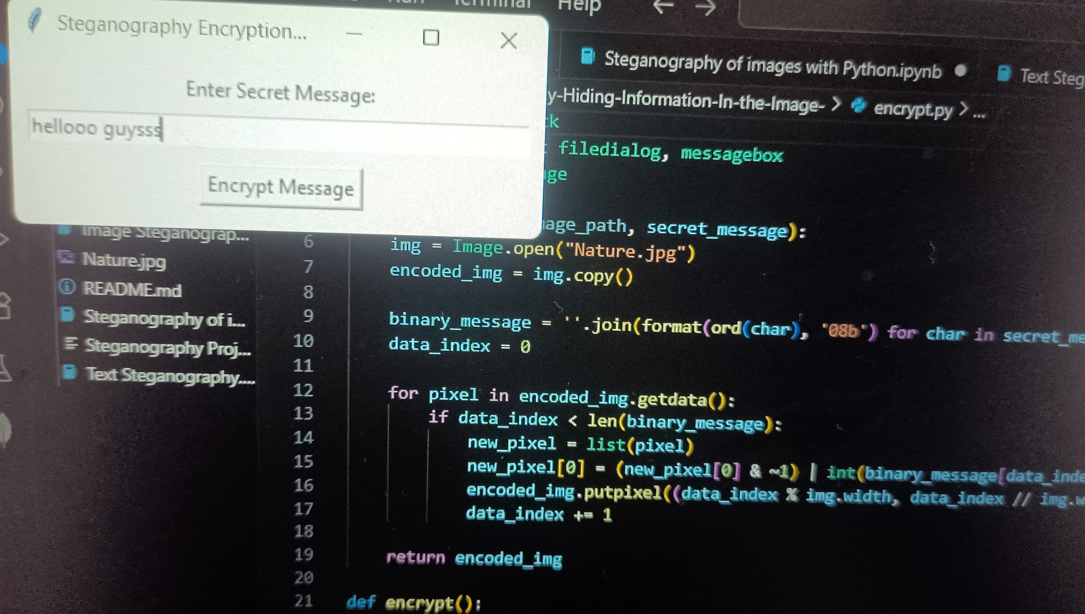
RESULT
GITHUB LINK : https://github.com/ganapati113/Edunet-Foundation-Steganogarphy-Hiding-Information-In-the-Image.git

Slide 7
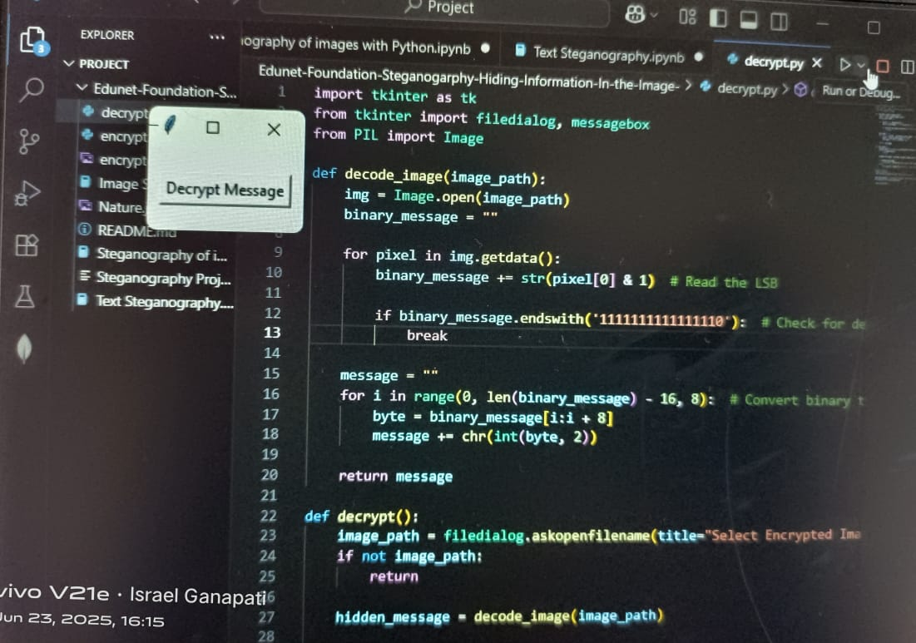
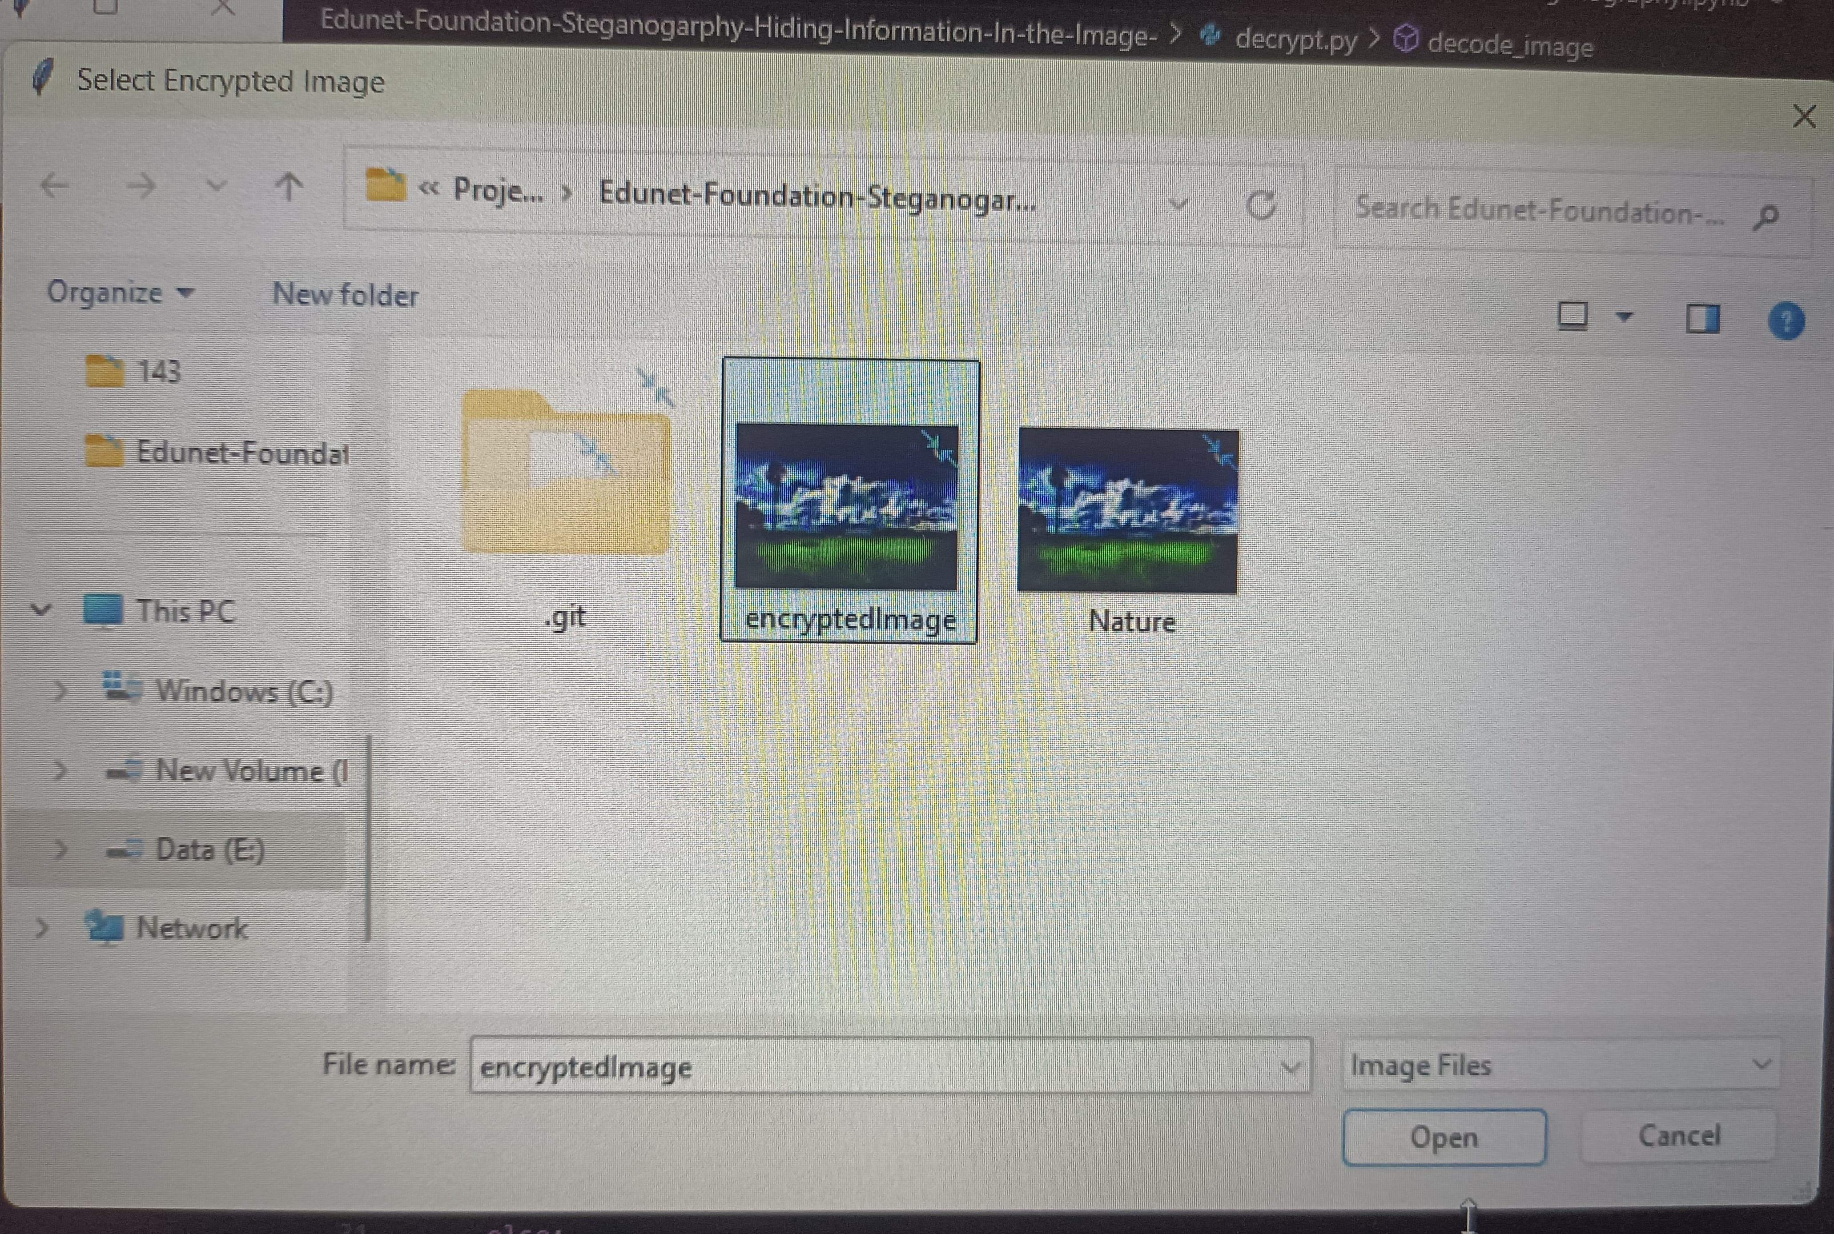
RESULT

Slide 8
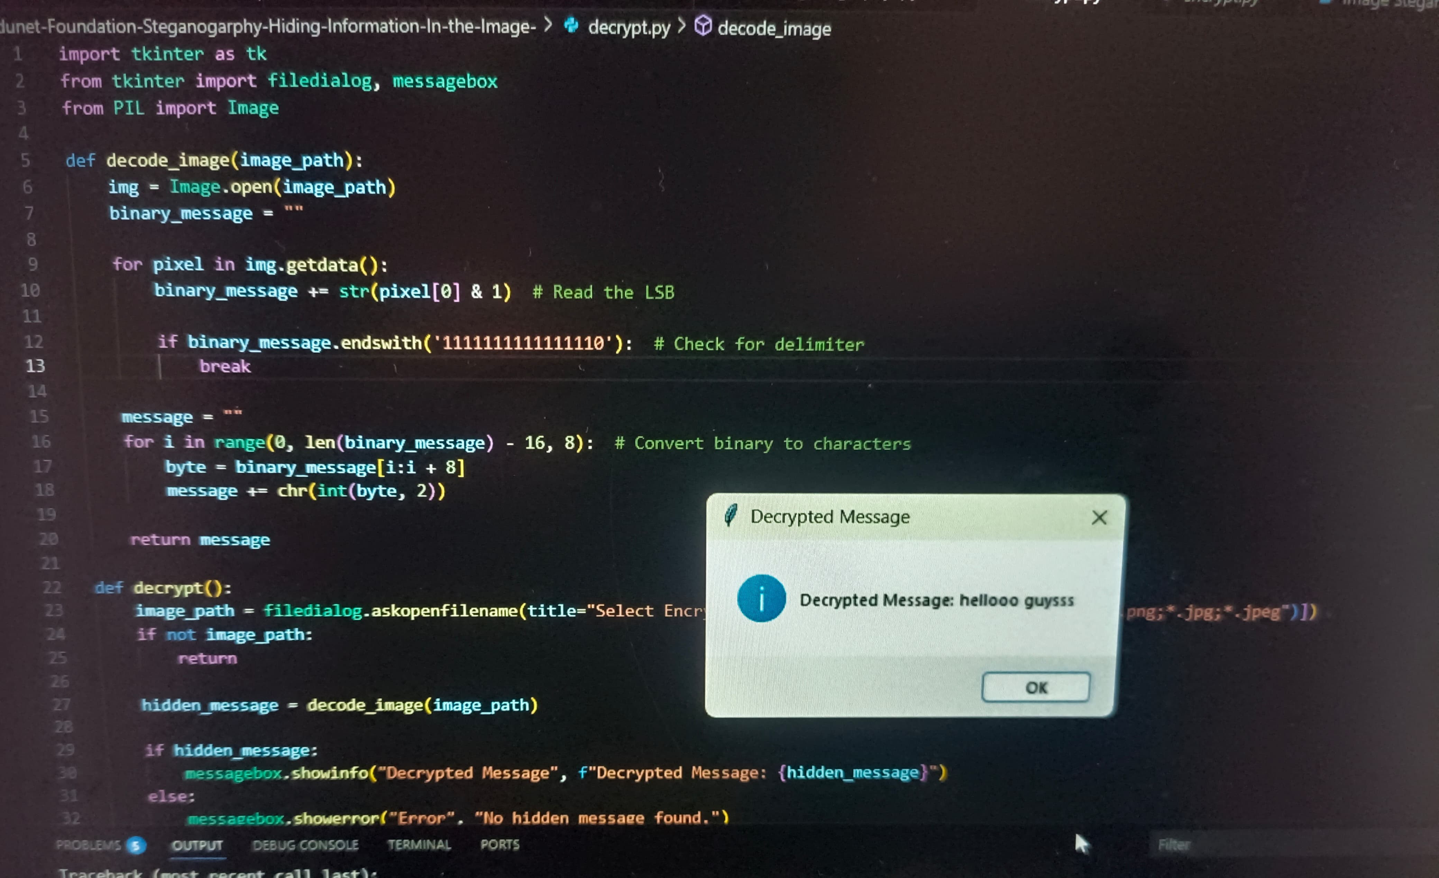
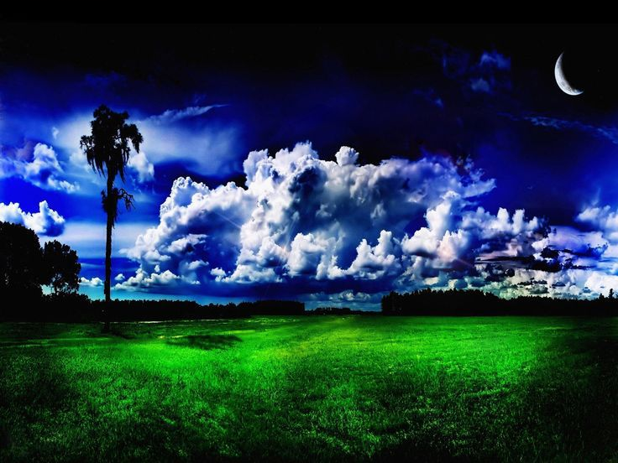
RESULT

Slide 9
CONCLUSION
In this project, we successfully demonstrated the use of steganography to hide and retrieve secret messages within digital
images. By using the Least Significant Bit (LSB) technique, the project ensured that the image's visual integrity was
maintained while securing confidential data within its pixels.
The system proved effective in:
Concealing data without altering image quality,
Ensuring easy encryption/decryption via a user-friendly Python GUI,
Providing hands-on understanding of image processing, data security, and basic encryption.
Challenges Encountered:
Managing image formats and pixel limits for larger messages.
Ensuring message integrity during encoding and decoding.
Handling image resizing and format conversion without data loss.
Potential Improvements:
Supporting more image channels (Green, Blue) for better data capacity.
Adding password protection and data compression.
Expanding to multimedia steganography (audio/video) and cloud integration.
This project lays a strong foundation for real-world applications in secure communication, cybersecurity training, and digital forensics.

Slide 10
FUTURE SCOPE
The project on steganography opens the door to several advanced real-world applications and research directions:
Enhanced Security & Privacy: Integrating with encryption and authentication systems to improve secure communications.
Multimedia Steganography: Expanding the technique to audio, video, and other digital formats.
AI & Machine Learning Integration: Using AI for intelligent embedding, detection, and anomaly spotting in steganographic content.
Blockchain + Steganography: Combining decentralized technologies for tamper-proof data hiding.
Digital Forensics & Anti-Steganography: Tools for forensic analysis and detecting stego-attacks.
IoT Security: Embedding data in IoT sensor feeds for secure data transfer.
Cross-Platform Compatibility: Ensuring steganography techniques work seamlessly across devices and platforms.
Digital Rights Management (DRM): Using steganography to protect intellectual property and watermarking.
Legal & Regulatory Considerations: Understanding ethical use and ensuring compliance with privacy laws.
Research & Innovation: Developing new algorithms, improving performance, and exploring novel use-cases.

Slide 11
REFERENCES
R. Chandramouli & N. Memon – “Analysis of LSB Based Image Steganography Techniques”, Proceedings of IEEE ICIP, 2001. ↳ Fundamental concepts behind Least Significant Bit (LSB) encoding used in our model.
Neil F. Johnson & Sushil Jajodia – “Exploring Steganography: Seeing the Unseen”, IEEE Computer, Feb 1998. ↳ Provided core understanding of steganographic principles.
Python Imaging Library (PIL/Pillow) – Official Documentation ↳ Used for image processing, reading, and modifying pixel data.
Tkinter GUI Toolkit – Python Standard Library Docs ↳ Enabled user interaction through a graphical interface for encryption/decryption.
GeeksforGeeks & W3Schools – Tutorials on Steganography and GUI development in Python. ↳ Helped in shaping beginner-friendly LSB-based steganographic implementation.
Edunet Foundation Curriculum – Hands-on activities and theoretical foundations on data security and encryption. ↳ Structured learning goals and objectives around real-world cybersecurity applications.

Slide 12
I would like to express my heartfelt gratitude to Edunet Foundation for providing this wonderful opportunity to be part of the 6-week Internship in collaboration with IBM. This journey has been incredibly enriching, allowing me to explore real-world cybersecurity concepts like steganography in depth. I sincerely thank all the mentors, coordinators, and organizers who guided and supported me throughout. This experience has truly enhanced my technical and professional skills, and I'm thankful to be a part of this learning community.

